Slide 1


VISVESVARAYA TECHNOLOGICAL UNIVERSITY JNANASANGAMA, BELAGAVI-590 018
Final Project Progress Report on
VEHICLE SUPPORT SYSTEM
Submitted in partial fulfillment for the award of degree of
Master of Computer Applications
Submitted by
ABHISHEKA B
4VZ16MCA01
Project Carried out
at
VTU PG CENTER
Hanchya, Sathagalli Ring Road,
Mysuru-570029.
Internal Guide
Prof. SOWJANYA M N
Assistant Professor
VTU PG Center, Mysuru.

Slide 2

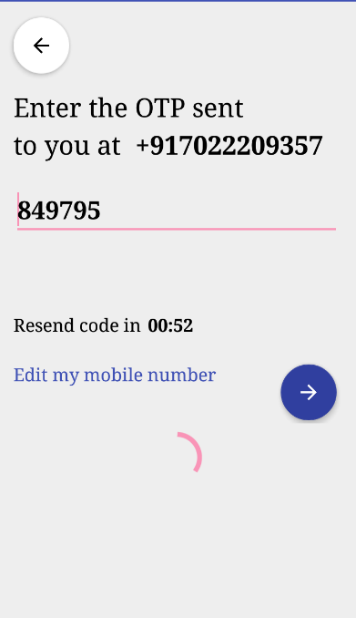
“Vehicle Service” Application
Fig 1. Starting page
Fig 2. Verification page

Slide 3
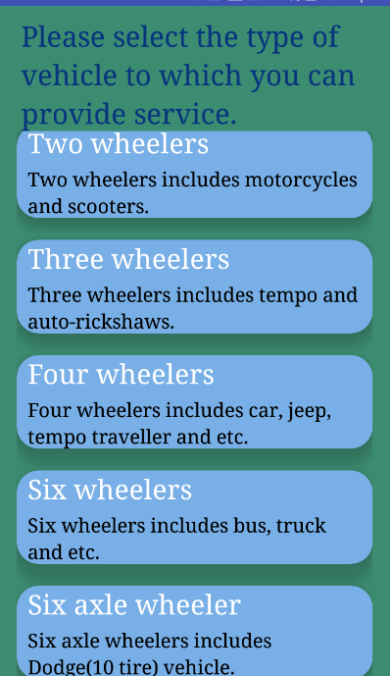
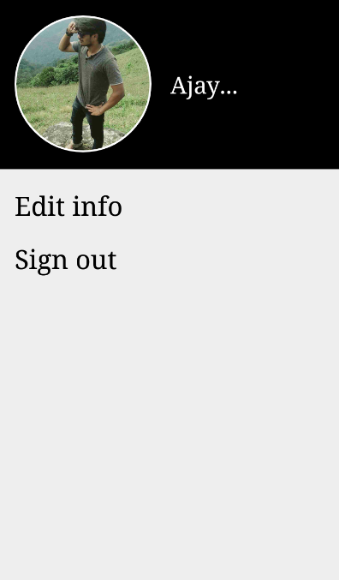
Fig 3. Vehicle selection page
Fig 4.Customer account page

Slide 4
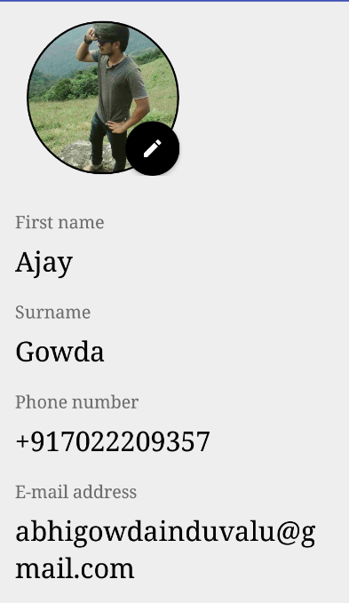
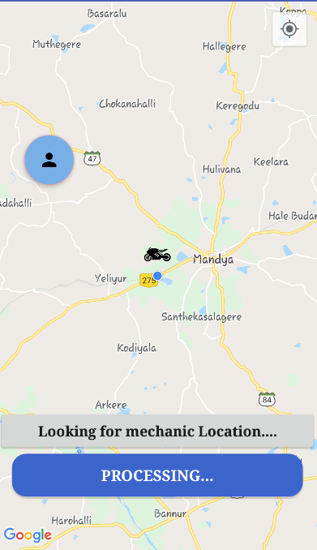
Fig 6. Request page
Fig 5. Edit profile page

Slide 5
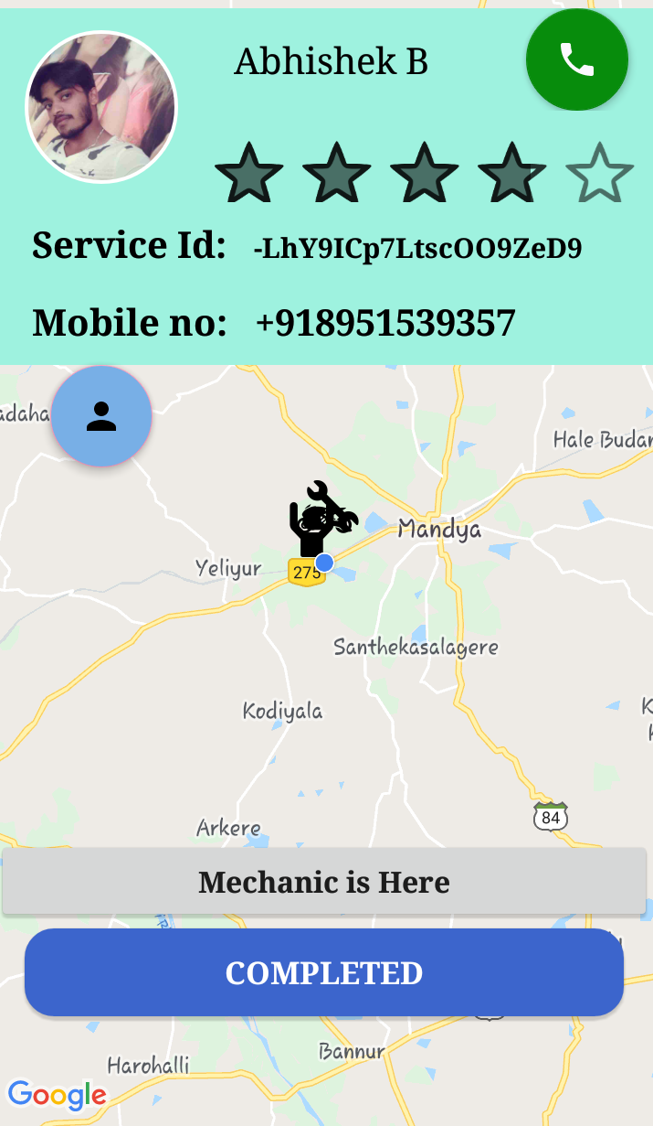
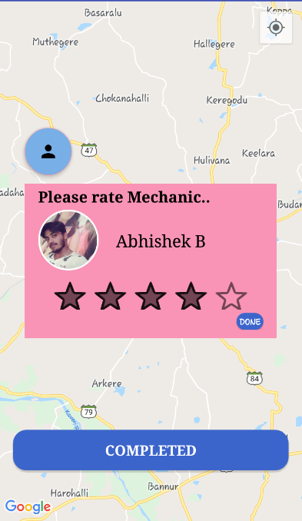
Fig 8. Rating page
Fig 7. Map page after mechanic found

Slide 6
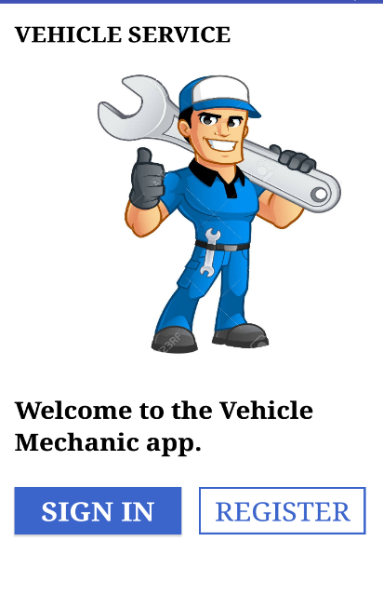
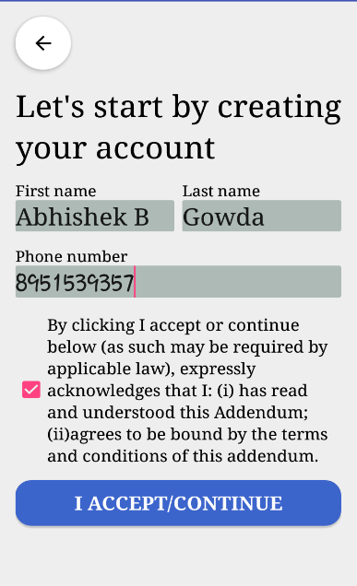
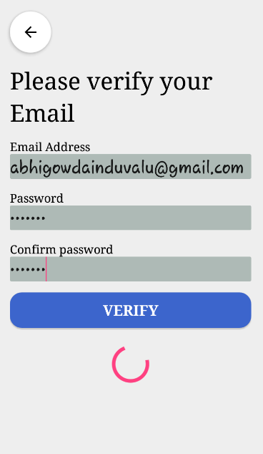
Screen shots
“Vehicle Mechanic” Application
Fig 1. Starting page
Fig 2. Registration page 1
Fig 3. Registration page 2

Slide 7
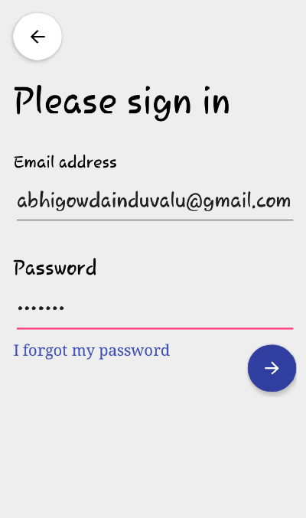
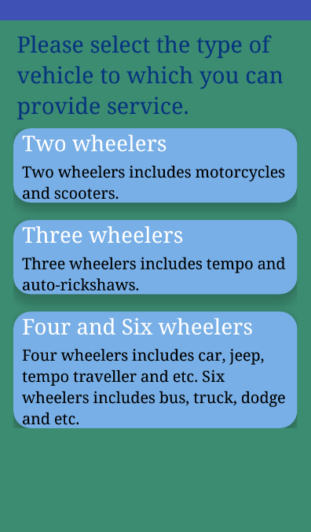
Fig 4. Login page
Fig 5. Vehicle selection page

Slide 8
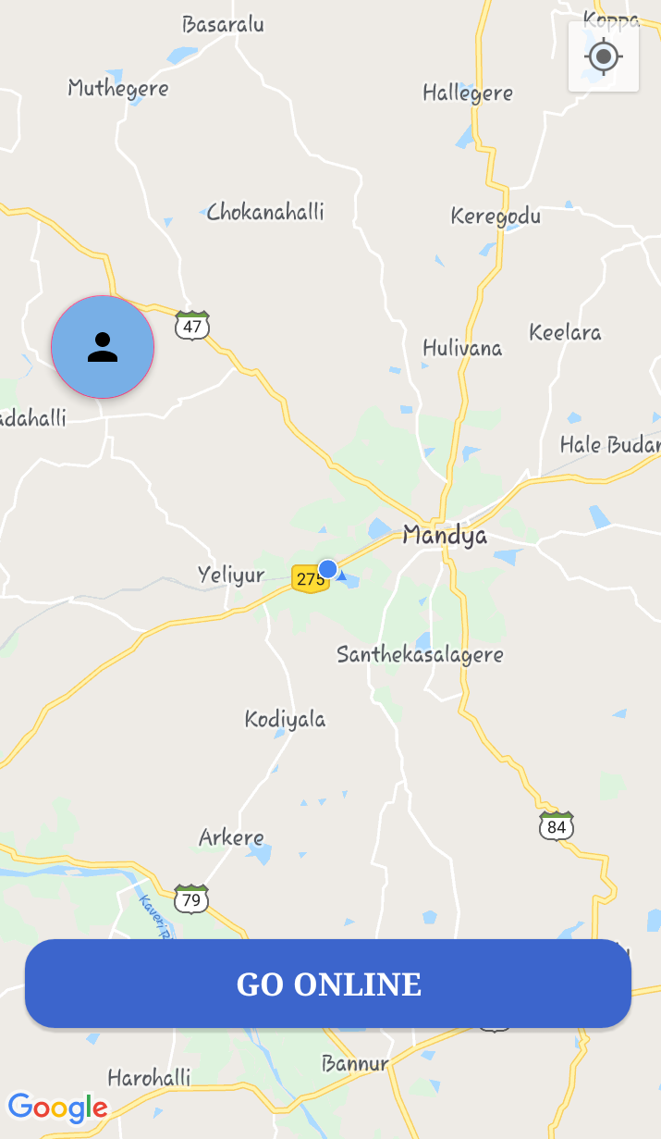
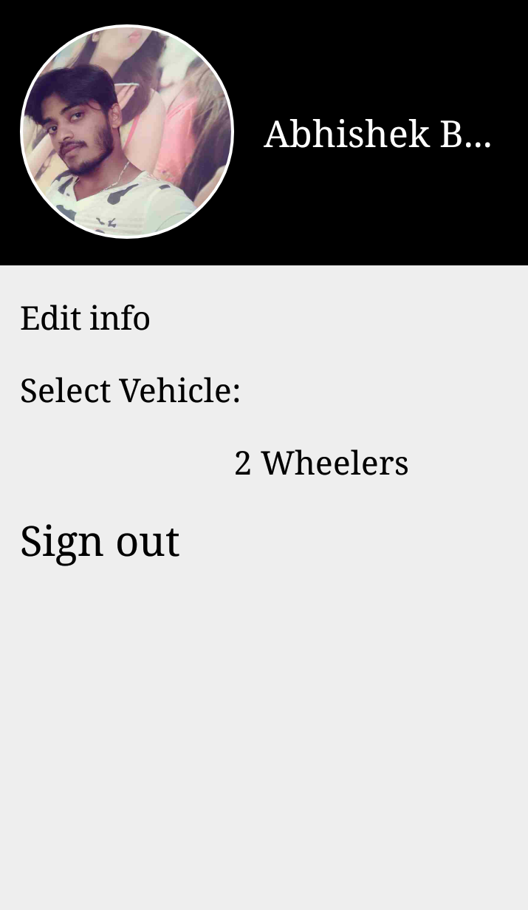
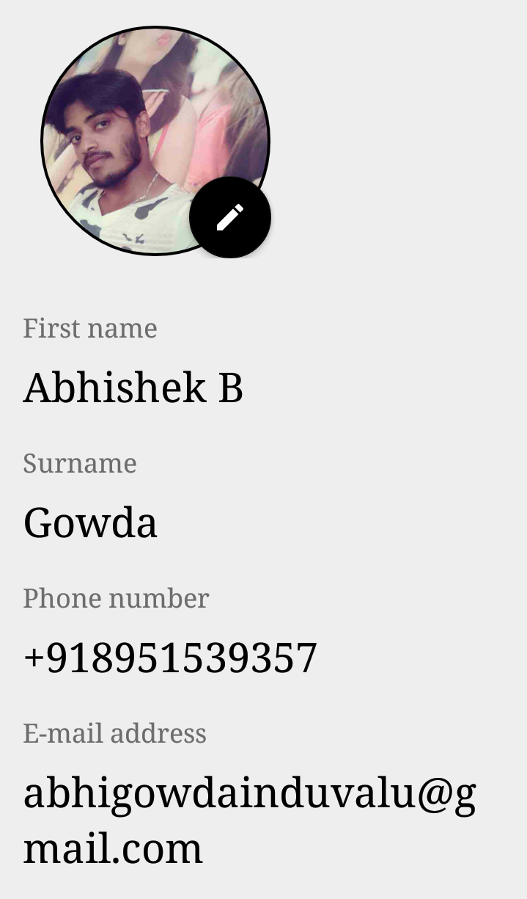
Fig 6. Map page
Fig 7. Account Activity
Fig 8. Edit profile page

Slide 9
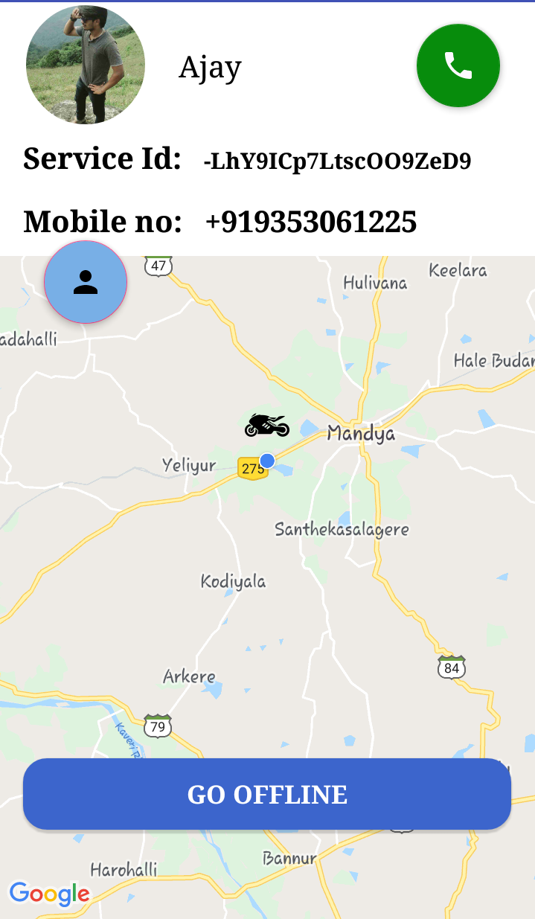
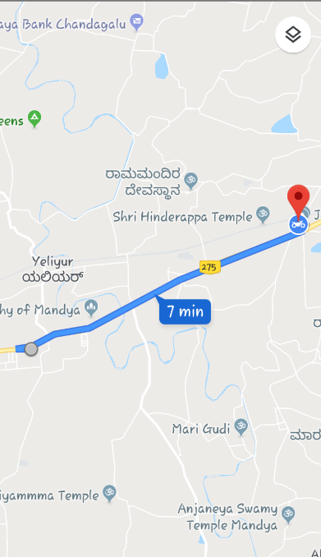
Fig 9. Map page with customer request
Fig 10. Map with direction

